Slide 1
Teaching Squares: Growing Your Teaching Practice Through Classroom Observation
Peer Observation Program
Tonya Buchan (she/her)
Jennifer Todd (she/her)
Notes:
Closing SESSION - 60 minutes
Teaching Squares is a peer observation program that allows faculty, instructors, and GTAs to observe, learn from, and support each other in their quest to become better instructors.
It is designed to be a non-evaluative, supportive, and growth-based process.
Participants are coached in giving individualized, supportive, and constructive feedback using observation forms aligned with the Teaching Effectiveness Framework.
Through the observation process, participants are encouraged to not only give feedback but also reflect on their own practice.

Slide 2
Our Community Agreement...
TBD
TBD
TBD
TBD
Maintain confidentiality
Notes:
[end at :09]
TS at CSU is a powerful combination comprised of 4 components. Most TS programs include the first 3. I’ll talk about the foundation of TS in a few minutes.
The direct inclusion of Evidence-based Practices based on the CSU TEF gives participants the opportunity to hone in on the use of evidence-based teaching practices on the observation forms.
Jen will go into more detail about each component as well as the TEF in the next section…
NOTE: Gold boxes = participants quotes…

Slide 3
Announcements
TILT Summer Conference
May 15 - 16
Conference Theme:
Supporting Today’s Students
Keynote: Deborah A. Santiago
CEO of Excelencia in Education
Be sure to register ASAP!
Best Practices in Teaching (BPiT) Courses
3-weeks, online
May 20 - June 9
Teaching Online: Facilitation and Engagement
Critical Thinking
June 12 - July 2
Create Assignments
First Four Weeks
Accessible and Inclusive Content
Rethink the Syllabus
Notes:
[end at 10:10]

Slide 4
Post Observation #2 Feedback
What, So What, Now What?
Notes:
[end at :55]

Slide 5
Thank You!
On the blank cards on your table, write a thank-you, kudos, compliments, reminder of teaching strengths, words of wisdom etc., to each person in your Teaching Squares group.
Notes:
[end at :65]

Slide 6
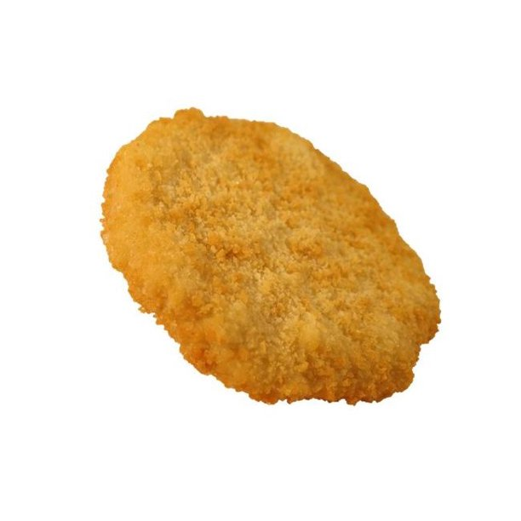
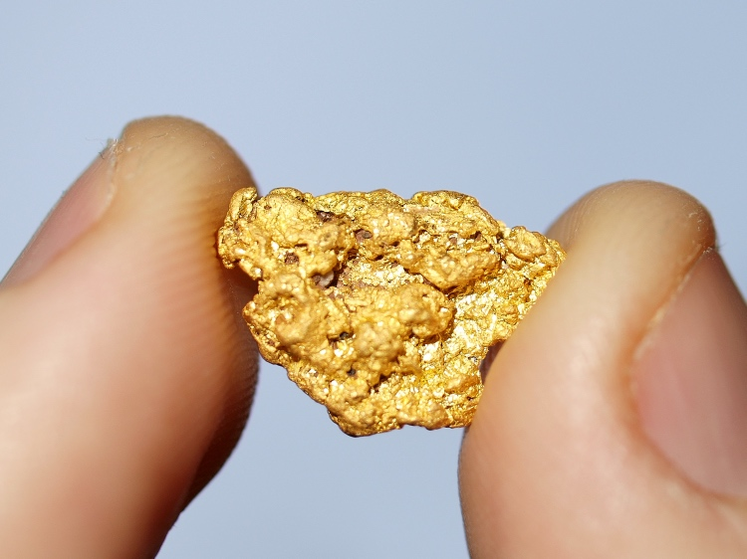
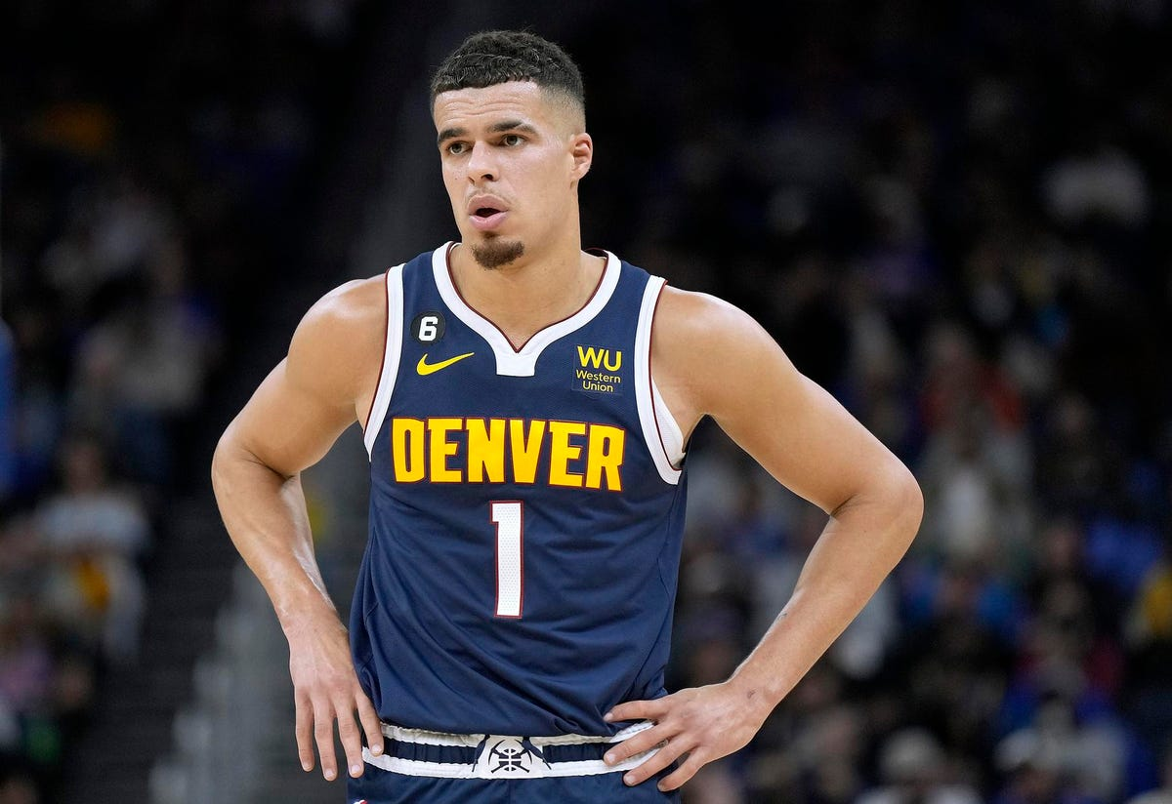
What is Your Teaching Squares Nugget?
Notes:
[end at :78]

Slide 7
Consider & Discuss...
Choose 1 question...
1. What have you learned about your teaching philosophy from your classroom observations (new or affirmed)?
2. How has the experience of again being in the “learner” role impacted your teaching?
3. What have you learned is one of your teaching strengths?
4. What aspect of your teaching do you wish to improve? How are you going to do this?
5. What surprised you during this experience? What assumptions about teaching were challenged by what you observed?
6. What is one thing you learned that will make your teaching more effective?
7. What is one thing you learned that you are going to apply next semester in your classroom?
Notes:
OPTIONAL [end at :78]

Slide 8
Earning Domain Experience Units (DEU’s)
Implement
Complete
Upload
Teaching Squares is eligible for 7 domain experience units (DEU) in one TEF domain.
Add practices from Teaching Squares into your courses
Complete a Post Implementation Reflection Form to describe and reflect on changes
Upload the Post Implementation Reflection Form to Bridge/ MyLearning/for approval
Questions?
Visit the TEI webpage or Tonya.Buchan@ColoState.Edu
Notes:
[end at :80]
Note to presenters:
The Teaching Effectiveness Initiative (TEI) is designed to encourage faculty to continuously grow in their teaching practice. The TEI uses the CSU Teaching Effectiveness Framework (TEF) to provide a common language to define teaching effectiveness in addition to evidence-based teaching practices.
Participants can earn a Certificate of Achievement in each of the seven domains of the TEF by completing acceptable professional development experiences.
The TEI is a voluntary program open to all faculty teaching at CSU. At this time, we are not able to offer the TEI for graduate teaching assistants or graduate students, so we encourage all graduate students at CSU to participate in the Graduate Teaching Certificate program.
Please encourage participants to visit the Teaching Effectiveness Initiative webpage or contact Tonya Buchan (tonya.buchan@colostate.edu) for detailed information.
TEF: https://tilt.colostate.edu/wp/prodev/teaching-effectiveness/tef/
TEI: https://tilt.colostate.edu/wp/prodev/teaching-effectiveness/tei/

Slide 9
The future...
Notes:
[end at :85]
Building/Extending the Teaching Squares Community
Keep the square going? Meet in the future?

Slide 10
Your Feedback is Important to us!
Notes:
[end at :90]

