Slide 1
Teaching Squares: Non-Evaluative and Supportive Peer Observation
Tonya Buchan (she/her)
Jennifer Todd (she/her)
Notes:
90 minutes
Materials:
Link to google folder: https://drive.google.com/drive/folders/1NW5Tc7aU2aXbNzJ50ihmzDirw_xjGGt8?usp=sharing
Workbook (sample): https://docs.google.com/document/d/1fpuhuoSehhJ5B_Q9RMgZizPmXeW96QLT/edit?usp=sharing&ouid=104297975633469088106&rtpof=true&sd=true (or https://col.st/orjQ3)
Practice observation forms: Classroom Climate or Instructional Strategies (linked in workbook)
Preload video before session: https://www.youtube.com/watch?v=V1ndfAWxib0&t=2s (Classroom Climate) or https://www.youtube.com/watch?v=sLRgP734J7g&t=257s (instructional strategies)
Teaching Squares is a peer observation program that allows faculty, instructors, and GTAs to observe, learn from, and support each other in their quest to become better instructors.
It is designed to be a non-evaluative, supportive, and growth-based process.
Participants are coached in giving individualized, supportive, and constructive feedback using observation forms aligned with the Teaching Effectiveness Framework.
Through the observation process, participants are encouraged to not only give feedback but also reflect on their own practice. Participants will leave with information and materials to implement this program at their own institutions.

Slide 2
Outcomes
Describe the Teaching Squares program philosophy
Explain the structure of Teaching Squares
Discuss the benefits of peer observation and personal reflection
Recognize how the Teaching Effectiveness Framework is used for observation and reflection
Implement Teaching Squares at your home institution
Notes:
Workshop outcomes include:
Talk about the TS program philosophy
Explain the TS structure
Discuss the benefits of peer observation and personal reflection
Recognize how the CSU TEF is used for observation & reflection
Be able to implement a TS program at your institution
Today you will learn about our Teaching Squares program by engaging in the kick-off session that we run with our faculty. This typically is a 90-minute session but we’re going to run a speed round so let’s get started!
Name Tent - name, dept, 1 teaching strength​
Find an Uncommon Commonality among group members

Slide 3
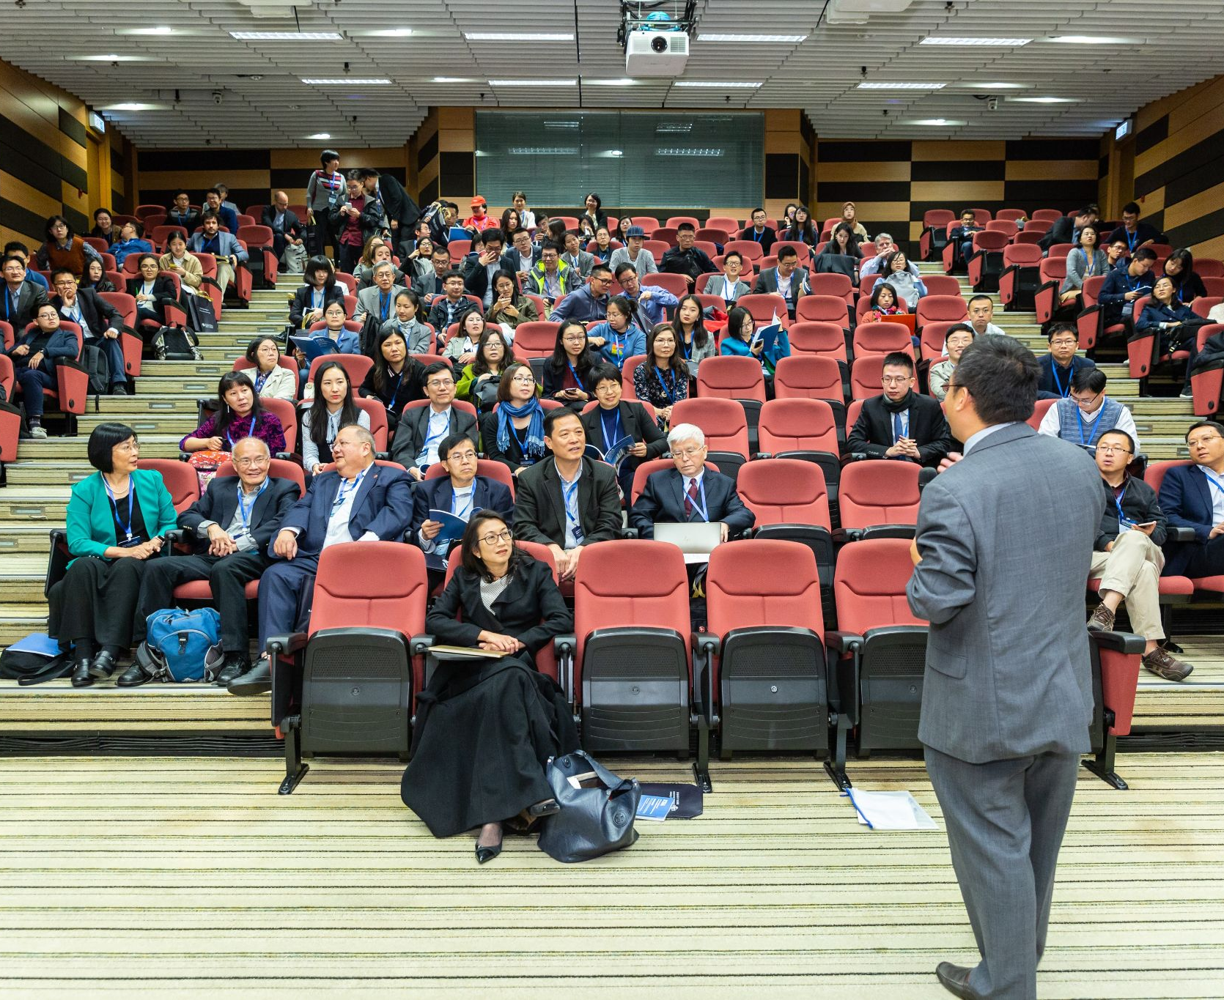
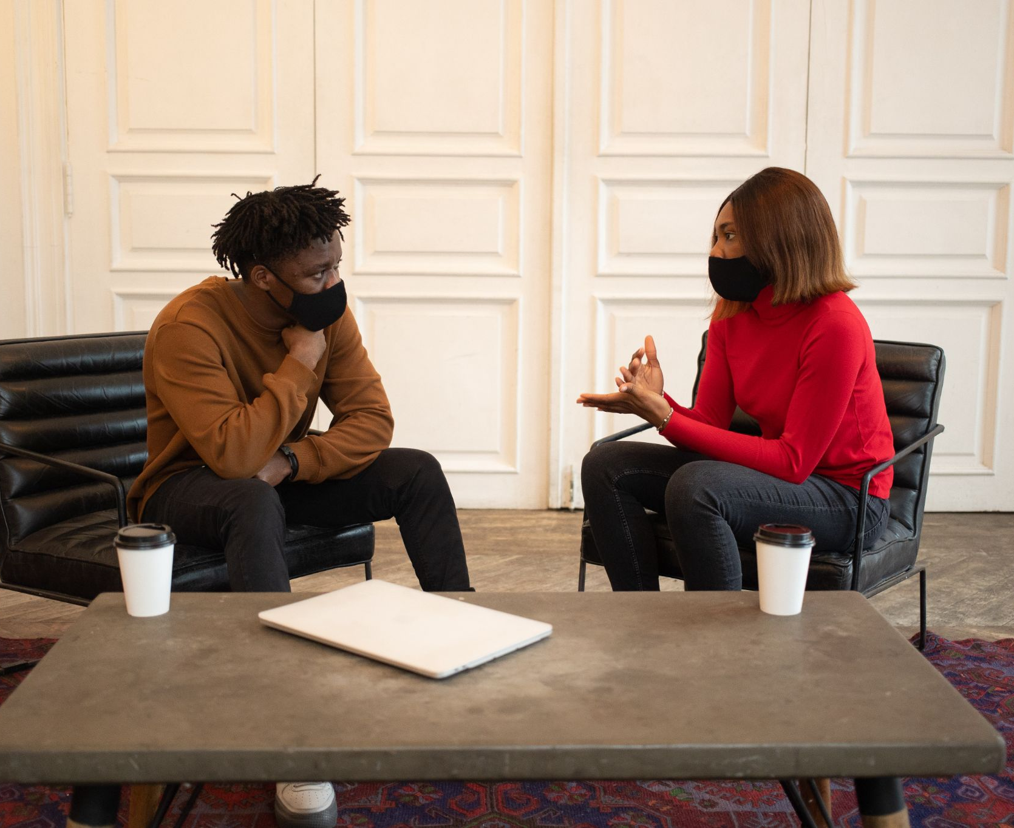
Six Main Aims of Peer Observation
Martin and Double (1998)
01 | Improving or developing an understanding of personal approaches to curriculum delivery
02 | Enhancing and extending teaching techniques through collaboration
03 | Exchanging insights relating to the review of teaching performance
04 | Expanding personal skills of self-reflection and evaluation
05 | Developing curriculum planning skills in collaboration with peers and colleagues and,
06 | Identifying areas in teaching practice with particular merit or in need of development.
Notes:
Peer observation is at the core of the program…
Photos courtesy of:
Photo by Katerina Holmes from Pexels
Photo by ICSA from Pexels
Photo by Monstera from Pexels

Slide 4
Reflection is one of the most underused but powerful tools for success. ~ Richard Carlson
Notes:
When considering reflection about teaching practices, John Dewey, a psychologist and philosopher who was heavily influential in educational reform, provides a relevant description: reflection is ‘‘the active, persistent and careful consideration of any belief or supposed form of knowledge in the light of the grounds that support it and the further conclusions to which it tends” (Dewey, 1933, p. 9). Reflective Practices in Education: A Primer for Practitioners Haleigh Machost & Marilyne Staines
The act of reflection in this context is meant to indicate a process. Dewey indicated the importance of active thinking when teaching. Take this time gives the instructor time to consider challenges in addition to what went well.
In other words, reflection entails considering past or present experiences, learning from the outcomes observed, and planning how to better approach similar situations in the future.
It is a journey of continual improvement when engaging in reflective practices.
According to Brookfield (2017), this is a contrast to how reflection is used typically used in higher education:
For many educators, the only time they engage in reflection is during annual review when they are asked to write documents that are used to evaluate whether they should be promoted, receive a raise, or be granted tenure.
When reflection is used in evaluation, it can be counterproductive and prevent meaningful reflections due to perceptions of judgment (Brookfield, 2017). Reflective Practices in Education: A Primer for Practitioners Haleigh Machost & Marilyne Staines

Slide 5
A Powerful Combination for Faculty Development
Peer Observation
Opportunity to:
watch other faculty in action
observe different ways of teaching
gain insight to different class environments (class size, content discipline, delivery method)
Collaborate with peers and engage in collegial conversations about teaching
Engage in a productive and supportive feedback environment
Self-Reflection
Opportunity to:
identify areas for growth
acknowledge, celebrate, and learn from personal successes
step back and consider if/how students are benefitting from the learning experience
Enhance innovation
Empowers change
Continually improve one’s own efficacy and abilities as an educator
Notes:
TS combines the power of peer observation and self-reflection.
Discuss the benefits of peer observation and personal reflection

Slide 6
Foundation of Teaching Squares
Reciprocity & Collaboration
Appreciation
Self-Reflection
Respect
Helpful to be in a “student” role again and think about how teaching strategies land.
Notes:
Outcome: Describe the Teaching Squares program philosophy
Developed at St. Louis Community College and popularized at Stonehill College, Teaching Squares offers instructors “an opportunity to gain new insight into their teaching through a nonevaluative process of reciprocal classroom observation and self-reflection.
TS is a small group of faculty who agree to observe each other.
Roots from community college & teaching colleges…
4 tenets form the foundation of TS
Collaboration & Reciprocity- shared responsibility for sharing, make time for each other, meet commitments
Appreciation - appreciative inquiry - come from a place of appreciation for other & your own teaching practice…
Mutual Respect - all learn from each other, vulnerability to invite someone into your classroom.
Self-referential reflection - power from looking inward and setting a goal from there…
NOTE: Faculty quotes- if you see the tan box, it’s a faculty quote

Slide 7
Teaching Squares is a team sport! Mutual Respect Reciprocity & Shared Responsibility
I found it really challenging that only 2 colleagues came to my class the first round and only 1 (a different from the first) came the second round. It didn't motivate me to rearrange my schedule to come to everyone else's classes. Participation in our square was an issue. I was also frustrated that some of my colleagues would tell me several times they were coming to class but then never showed up. I feel like I missed out on helpful feedback and it added extra stress to prepare my (small) class for an observer over several days.
Notes:
Teaching Squares is a team sport! like a group of skydivers trying to do a formation. Feedback from a participant who's square partners didn't follow through.
Everyone has a role and must rely on each other for it to work properly…

Slide 8
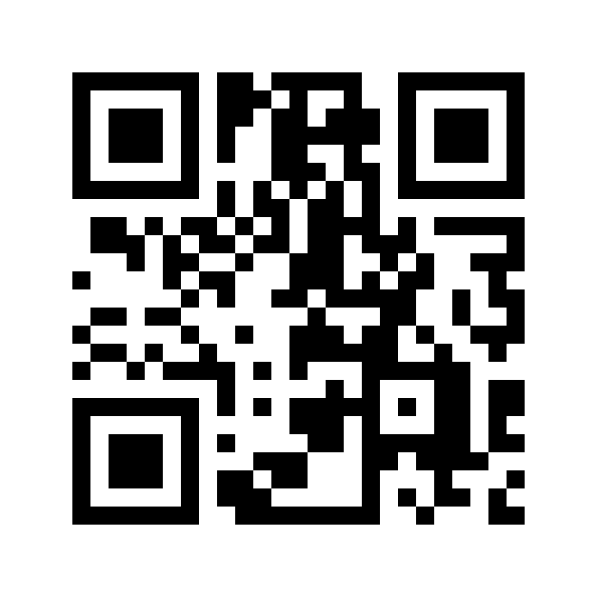
Logistics & Timeline
Kick-off Meeting
Pre-Observation Meeting
Observation Cycle 1
Observation Cycle 2
Norms
Practice observations
Form squares
Logistics
Distribute review form
Set up schedule for Observation Cycle 1
Instructors observe each other per schedule
Post-Observation Meeting 1
TILT facilitates feedback protocol
Instructors observe each other per schedule
Post-Observation Meeting 2
TILT facilitates feedback protocol
Prepare for Observation Cycle 2
Celebrations
Orientation
Teaching Squares Workbook
https://col.st/orjQ3
Notes:
Outcome: Explain the structure of Teaching Squares
Teaching Squares is conducted over 12-14 weeks and contains the following milestones identified on the slide.
Today we will address the Kick-off meeting.
The timeline and dates are included in the workbook.
Let’s look at the workbook now…

Slide 9
Community Agreement
Tell me what I do well (and what I could improve)
In order to create a safe space for us to practice teaching and feel supported while doing so, we agree to the following ground rules for the duration of our work together:
Maintain
confidentiality
“I just want to say midway through this program, that I have already gotten so much out of the experience! Thank you so much to you and everyone else involved with putting this together. This is my first semester teaching fully in-person and being a part of Teaching Squares is really adding to that experience.”
Notes:
In order to create a safe space for us to practice teaching and feel supported while doing so. On two different sticky notes, write down 2 different things you require when working with people you don’t know well. For example: “Look for what I do well” and “confidentiality”
We will collect the stickies and put them in groupings. We’ll revist them again at the end of the session.
We agree to the following ground rules for the duration of our work together:
Example norms
We are doing this for improvement. We will structure comments to build someone up rather than tear someone down.
We appreciate and respect everyone’s vulnerability in being a part of this program.
We will encourage each other to try new things and take on new challenges in the classroom.
We will be open to learning as well as commenting.
We will be present and engaged while observing.
Other:

Slide 10
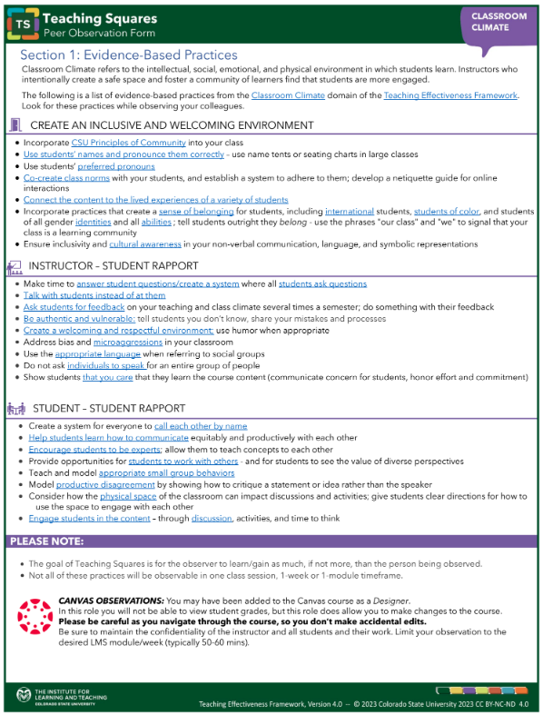
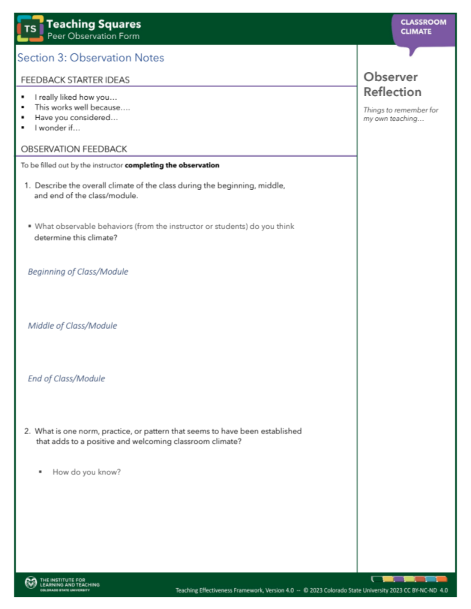
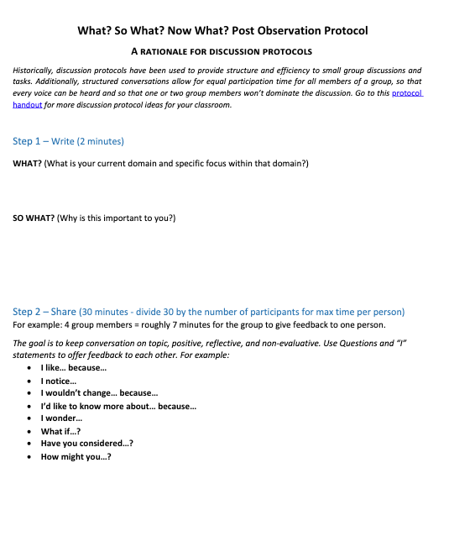
Supportive Feedback
Guided observation forms aligned with Teaching Effectiveness Framework
Observation forms integrate self-reflection
Facilitated feedback session with supportive discussion protocol
This should be an exercise required within a certain amount of time teaching at CSU. (It’s) AWESOME to watch and learn from my colleagues across the university.
Notes:
At Colorado State, we used the foundation of the TS program from other institutions and added components unique to our institution…
Teaching Squares is grounded in the Teaching Effectiveness Framework and can be used towards earning a domain in the TEI

Slide 11
Teaching Effectiveness Framework at a Glance
Notes:
OUTCOME: Recognize how the Teaching Effectiveness Framework is used for observation and reflection
[end at 11:40]
Framework and goal setting:
Share summary/cover sheet (pie) with description of each lens - Question: Which two are most exciting/intriguing to you and why? Be prepared to share with a partner
Think-pair-share
Narrow it down to one
Distribute Framework
Read through the framework, highlight what might be a goal for you for that ONE lens
(TB) handout pg. 3
The TEF is the 7 interrelated domains that given us a common language and tools allowing us to talk about teaching, develop teaching effectiveness and evaluate teaching at CSU.
It was developed by us and 2 colleagues from TILT.
It’s grounded in evidence-based teaching practices, more deets on website that we’ll share at the end of the session.

Slide 12
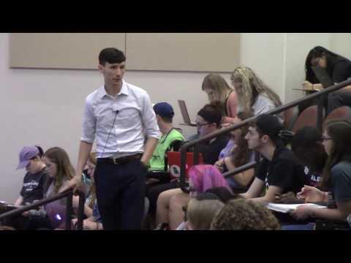
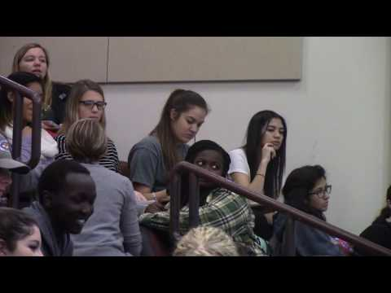
Let’s Practice…
Introductory Biology for non-majors
Genes & alleles
Instructional Strategies
Introductory Biology for non-majors​
The immune system & HIV
Classroom Climate
Notes:
Practice observations
Fill out observation sheet for one example, two if time
Practice Observations:
Classroom Climate- https://drive.google.com/file/d/1KSjX1b3FteVwQjp2xTms8Han6EbvJATD/view?usp=sharing
Instructional Strategies - https://drive.google.com/file/d/14u4Zhd49o-TdAAlVXAW13ASgCUFoGyNh/view?usp=sharing
https://www.youtube.com/watch?v=V1ndfAWxib0&t=2s (Classroom Climate)
https://www.youtube.com/watch?v=sLRgP734J7g&t=257s (Instructional Strategies)
Check the book from Amy for observation practice…

Slide 13
Next Steps
Pre-Observation Meeting
Observation Cycle 1
Bring a review form for each member
Set up schedule for Observation Cycle 1
Instructors observe each other per schedule
Post-Observation Meeting 1
TILT facilitates feedback protocol
Prepare for Observation Cycle 2
Prepare for the pre-observation meeting
Check your calendars now...
Class schedules don't conflict
Set pre-observation meeting
Notes:
Next Steps
You have a few minutes to set up your pre-observation meeting. Bring your review forms.

Slide 14
Our Community Agreement…
In order to create a safe space for us to practice teaching and feel supported while doing so, we agree to the following ground rules for the duration of our work together:
Maintain confidentiality
Be kind to myself
Provide feedback that is meaningful and clear
Respect each other’s time by meeting deadlines and commitments
Keep an open mind about approaches to teaching and help each other become the best version of ourselves
Notes:
At the start of the session, we asked you to write down 2 different things you require when working with people you don’t know well. While you were engaging in the practice observation, we organized them into groupings.
This is the compiled list. Do you agree to abide by this community agreement?
We’ll revisit them from time to time.

Slide 15
Unexpected Outcomes of the Program
Departments use program materials and run their own squares
Colleagues ask each other to conduct observations and write letters of recommendation outside of the program
Continued informal meetings and long-term friendships
A job
Thanks so much for this fantastic experience. I learned a lot that has already benefited me and my students. After a year or two of absorbing/implementing this material and pursuing complementary professional development opportunities, I'd love to do it again!

Slide 16
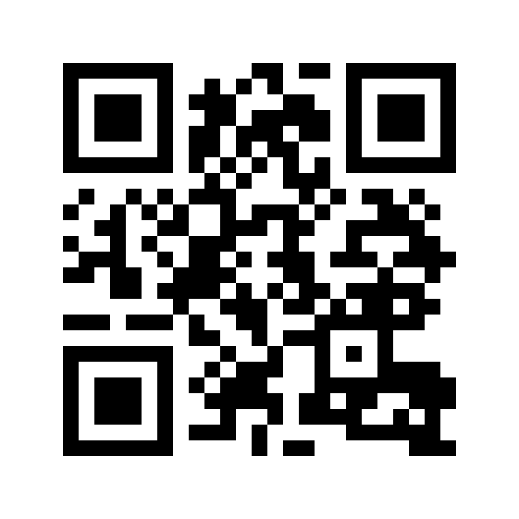
Thank you!
Tonya.Buchan@ColoState.Edu
Jennifer.Todd@Colostate.Edu

Slide 17
Resources
Berenson, C. Teaching Squares: Observe and Reflect On Teaching and Learning. Calgary, AB: Taylor Institute for Teaching and Learning at the University of Calgary, June 2017.
Colorado State University. Teaching Squares Program. https://tilt.colostate.edu/prodev/teaching-squares/
Durham College & University of Ontario Institute of Technology. Teaching Squares Handbook.
Haave, N. (2014). Teaching Squares: A Teaching Development Tool. The Teaching Professor, 28(10).
Kirker, M., Oberlies, M., Hernandez, C., & DeWaay, S. (2021). Teaching Squares: Improving instruction through observation and self-reflection. College & Research Libraries News, 82(8), 370. doi: https://doi.org/10.5860/crln.82.8.370
Martin, G. A., & Double, J. M. (1998). Developing Higher Education Teaching Skills Through Peer Observation and Collaborative Reflection. Innovations in Education and Training International, 35(2), 161–170. https://doi.org/10.1080/1355800980350210
Pacific Lutheran University, Teaching Squares Participant Handbook
Stonehill College. Teaching Squares: Participant Handbook.

